Slide 1
Programming in the "dark" ages
Rory Braybrook
@rbrayb

Slide 2
Two phases:
Mainframe
PC

Slide 3
The mainframe – circa 1970!

Slide 4
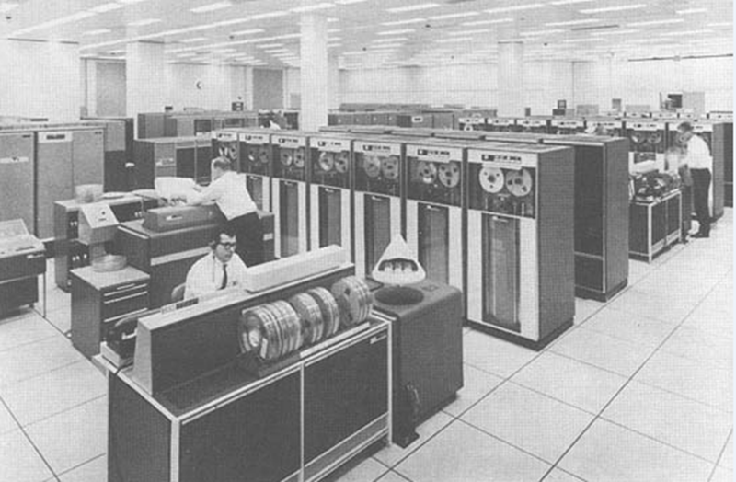
NASA mainframe - 1960

Slide 5
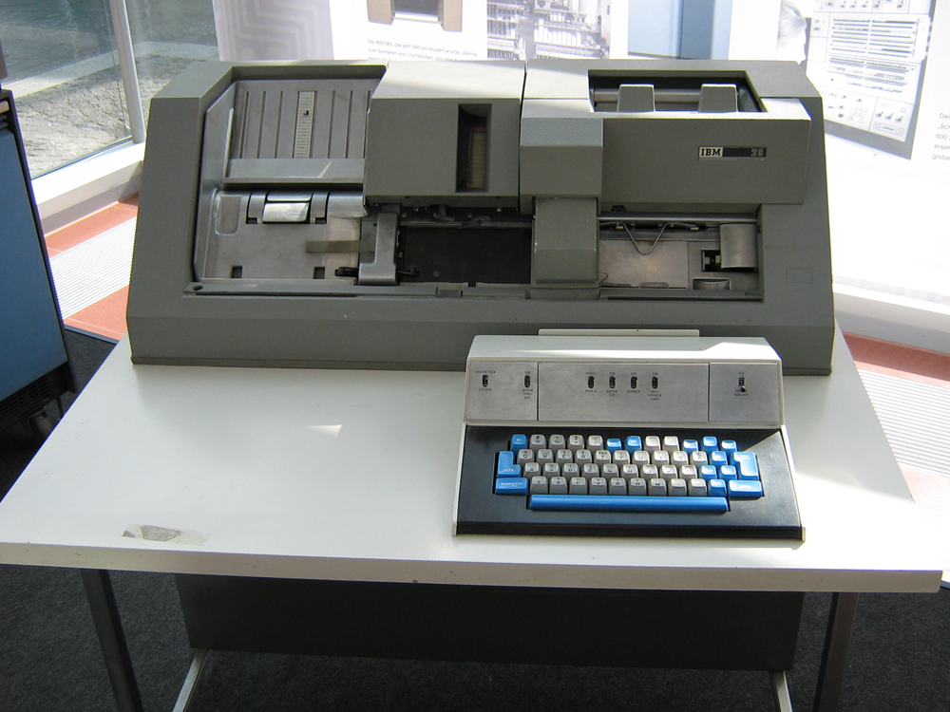
IBM card punch

Slide 6
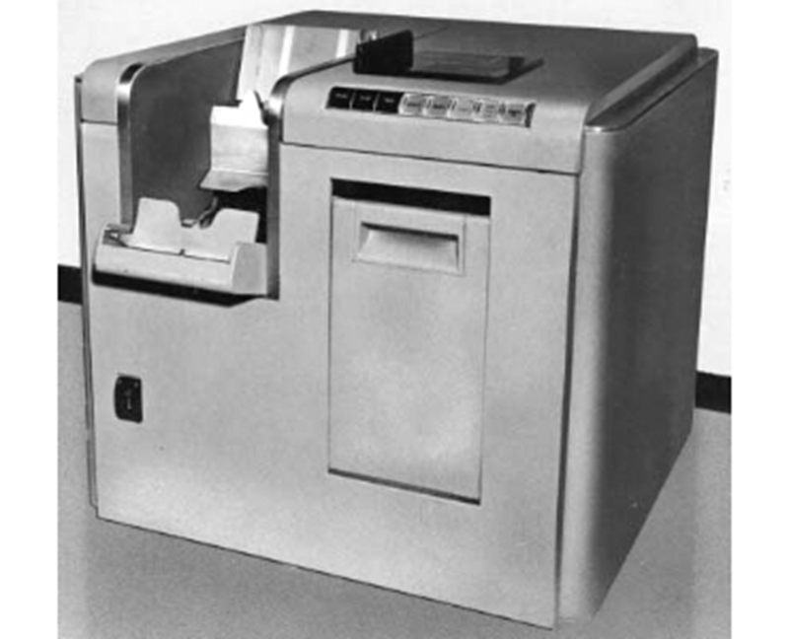
IBM card reader

Slide 7
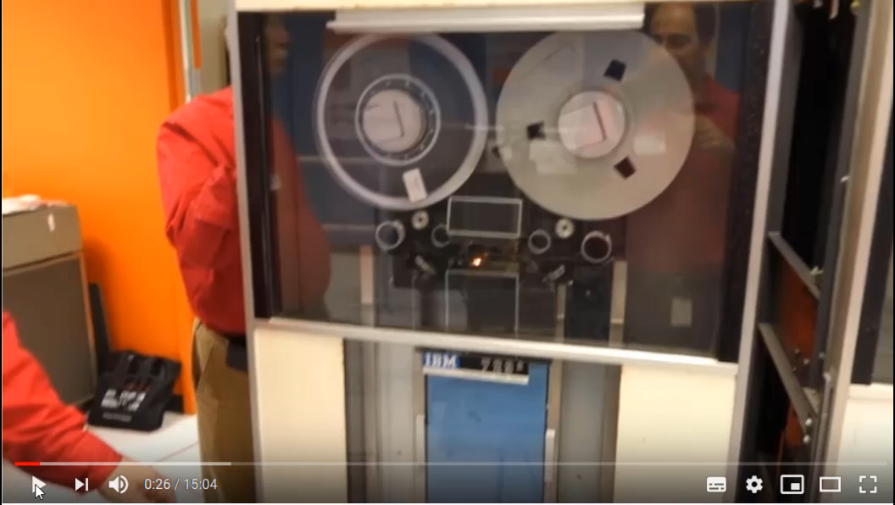
Tape drive

Slide 8
Tape drive
Initial tape speed was 75 inches per second (2.95 m/s) and recording density was 200 characters per inch, giving a transfer speed of 120 kbit/s.[
Later 729 models supported 556 and 800 characters/inch (transfer speed 480 kbit/s).
At 200 characters per inch, a single 2400 foot tape could store the equivalent of some 50,000 punched cards (about 4,000,000 six-bit bytes, or 3 MByte).

Slide 9
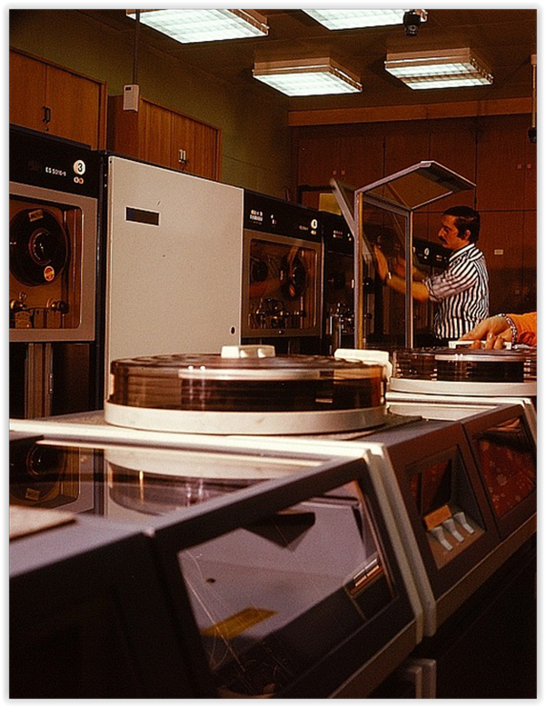
Disk drive

Slide 10
Disc drive
The first disk drive to use removable media was the IBM 1311 drive - two million characters.
It was followed by the IBM 2311 (1964) - 5 megabytes
The IBM 3330 - 100 megabytes
The 3330-11 - 200 megabytes

Slide 11
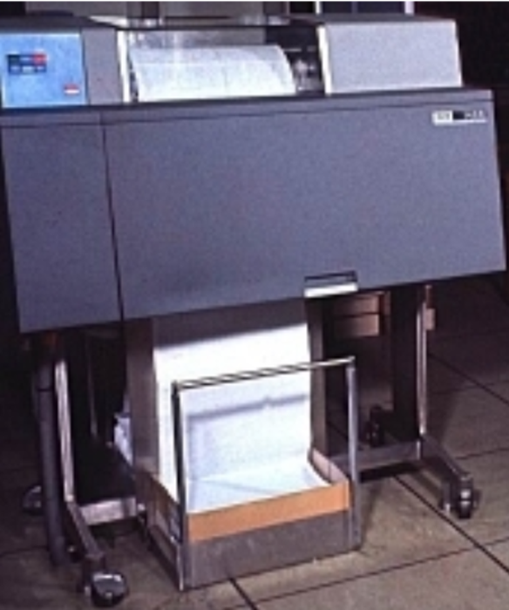
Printer

Slide 12
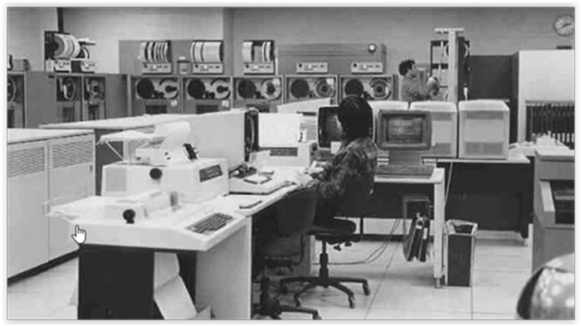
Control station

Slide 13
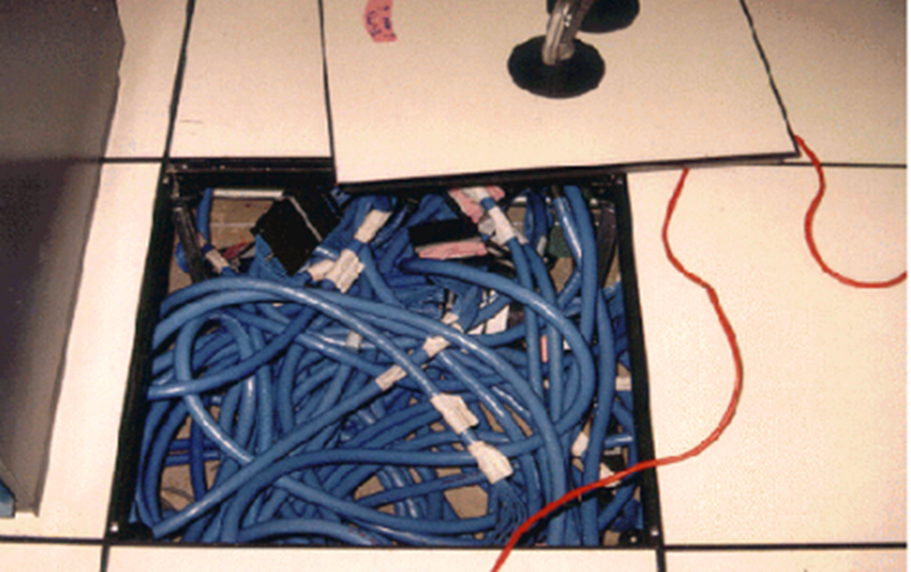
Raised floor

Slide 14
How to be a developer – circa 1970!

Slide 15
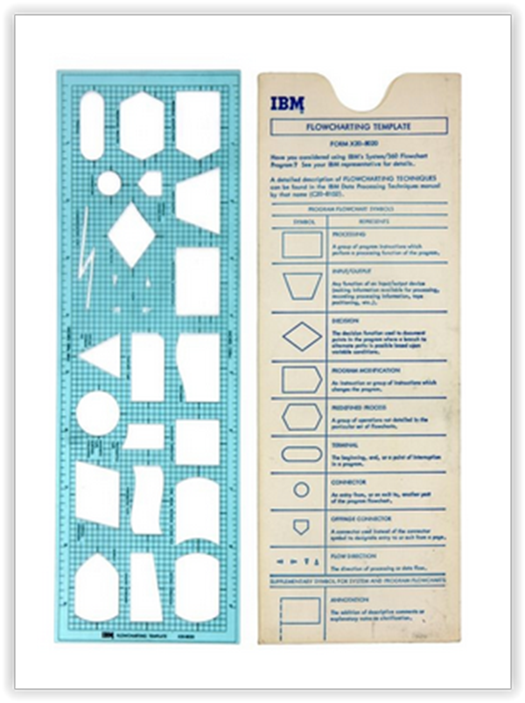
Flowcharting tool

Slide 16
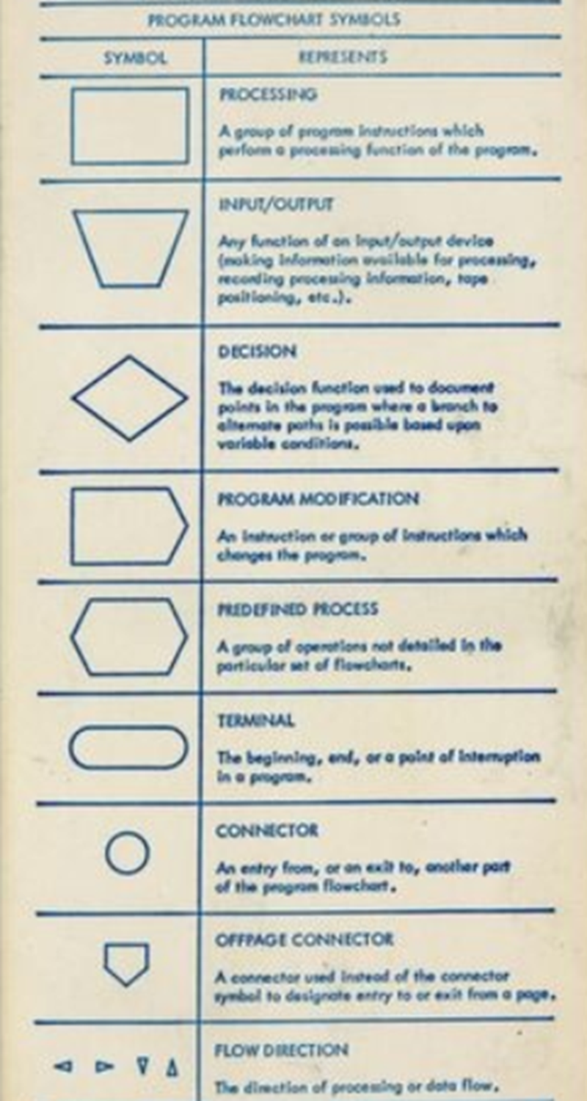
Flowcharting tool

Slide 17
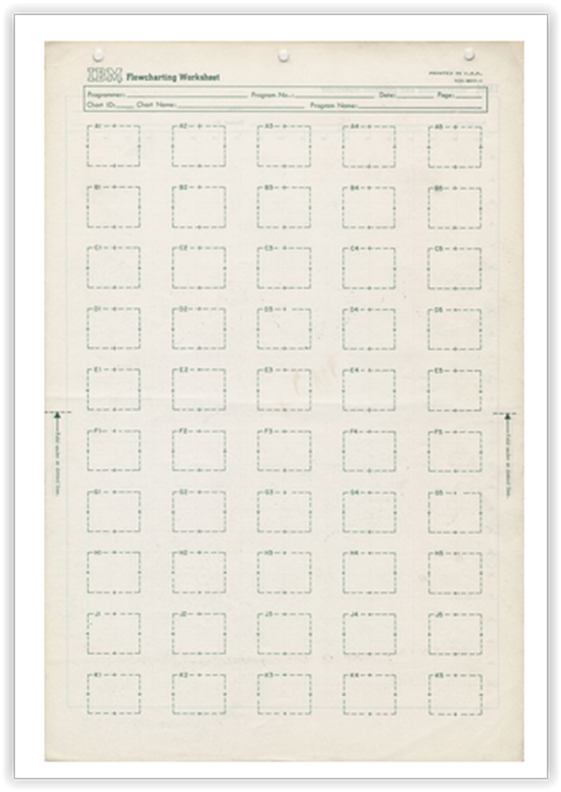
Flowcharting work sheet

Slide 18
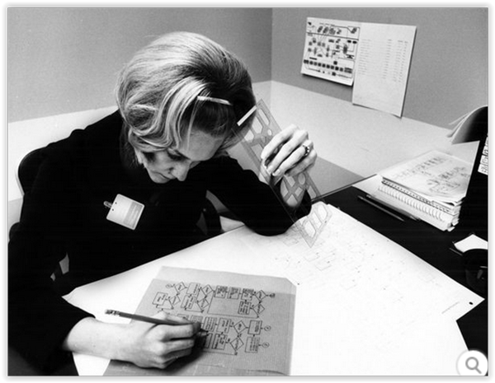
Flowcharting

Slide 19
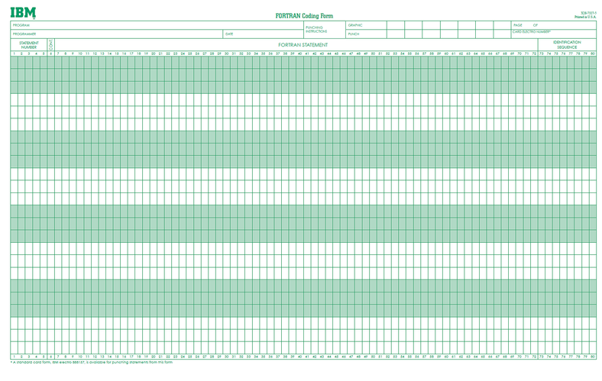
Punch card sheet

Slide 20
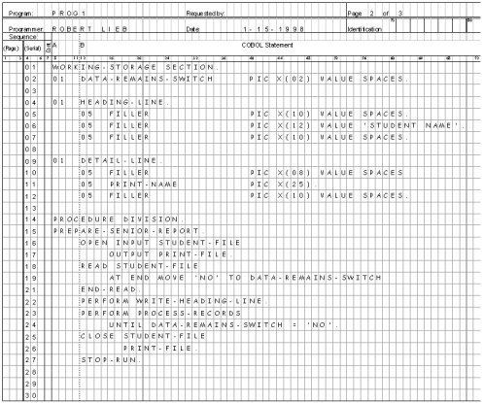
COBOL programming sheet

Slide 21
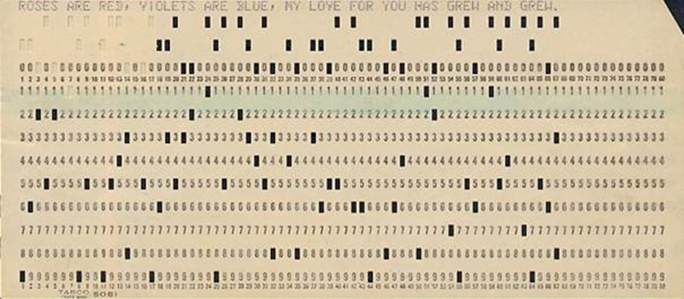
Punched card

Slide 22
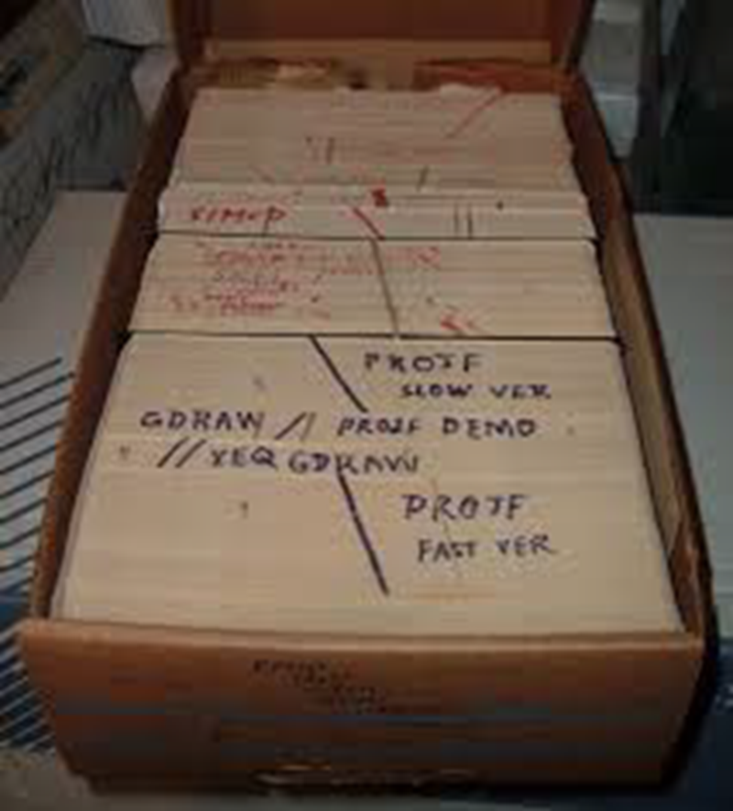
Punch card deck

Slide 23
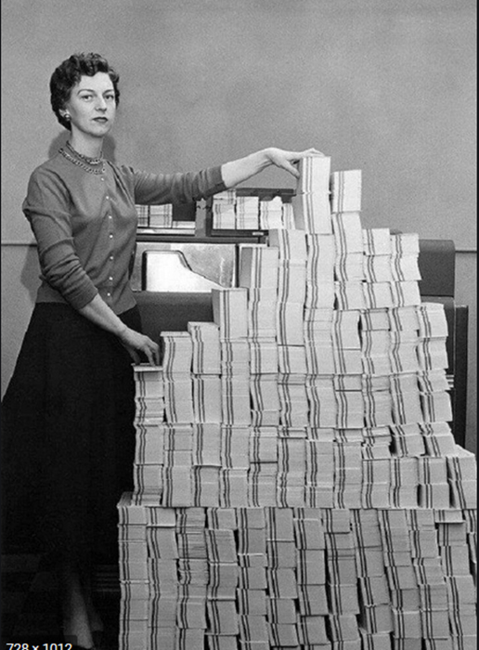
4.5 megabytes of data in 62,500 punched cards!

Slide 24
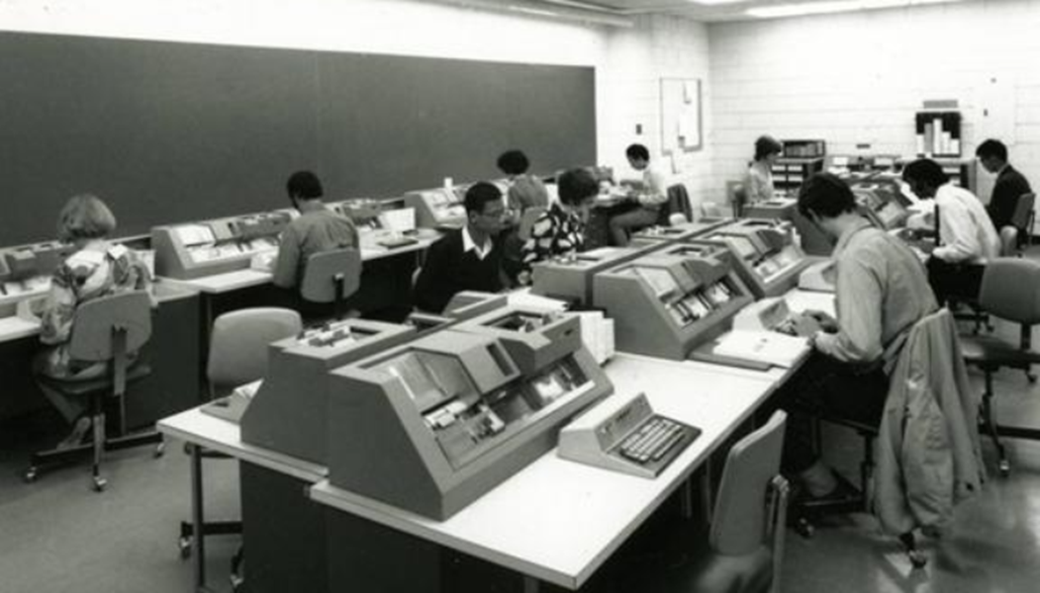
Hard at work

Slide 25
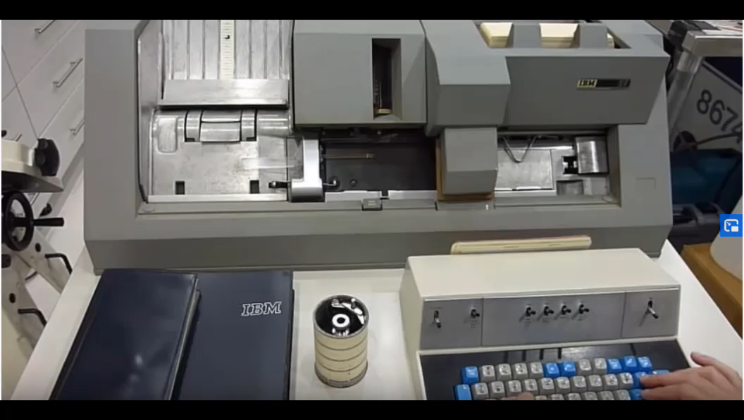
Punching the cards

Slide 26
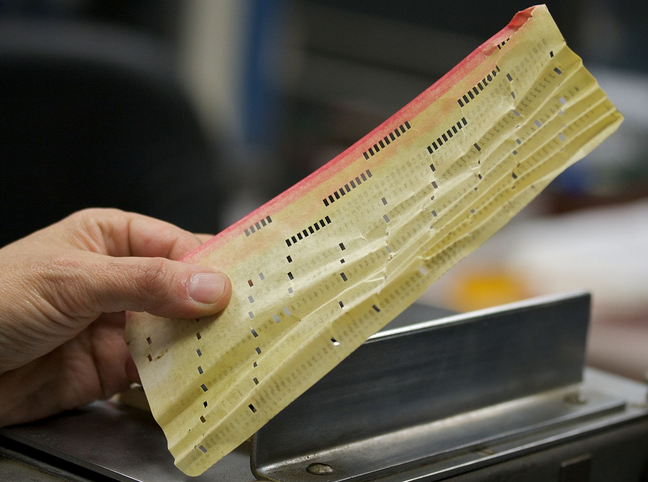
One mangled card!

Slide 27
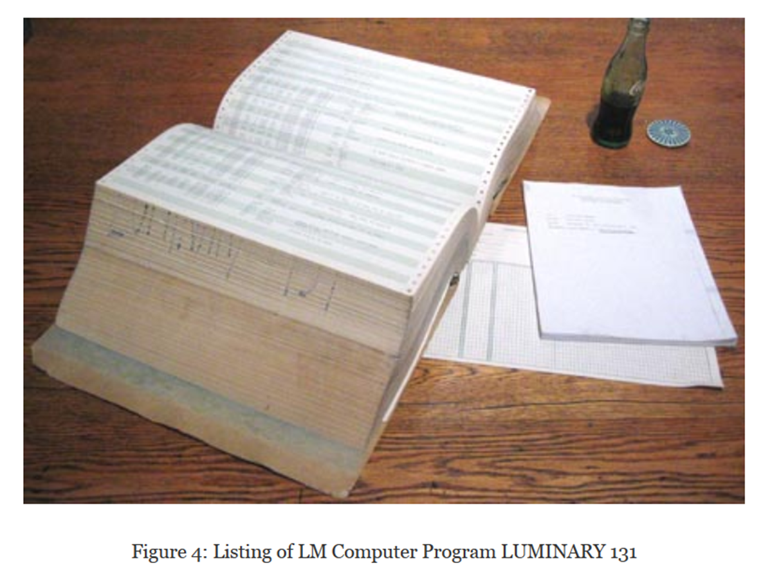
The source code

Slide 28
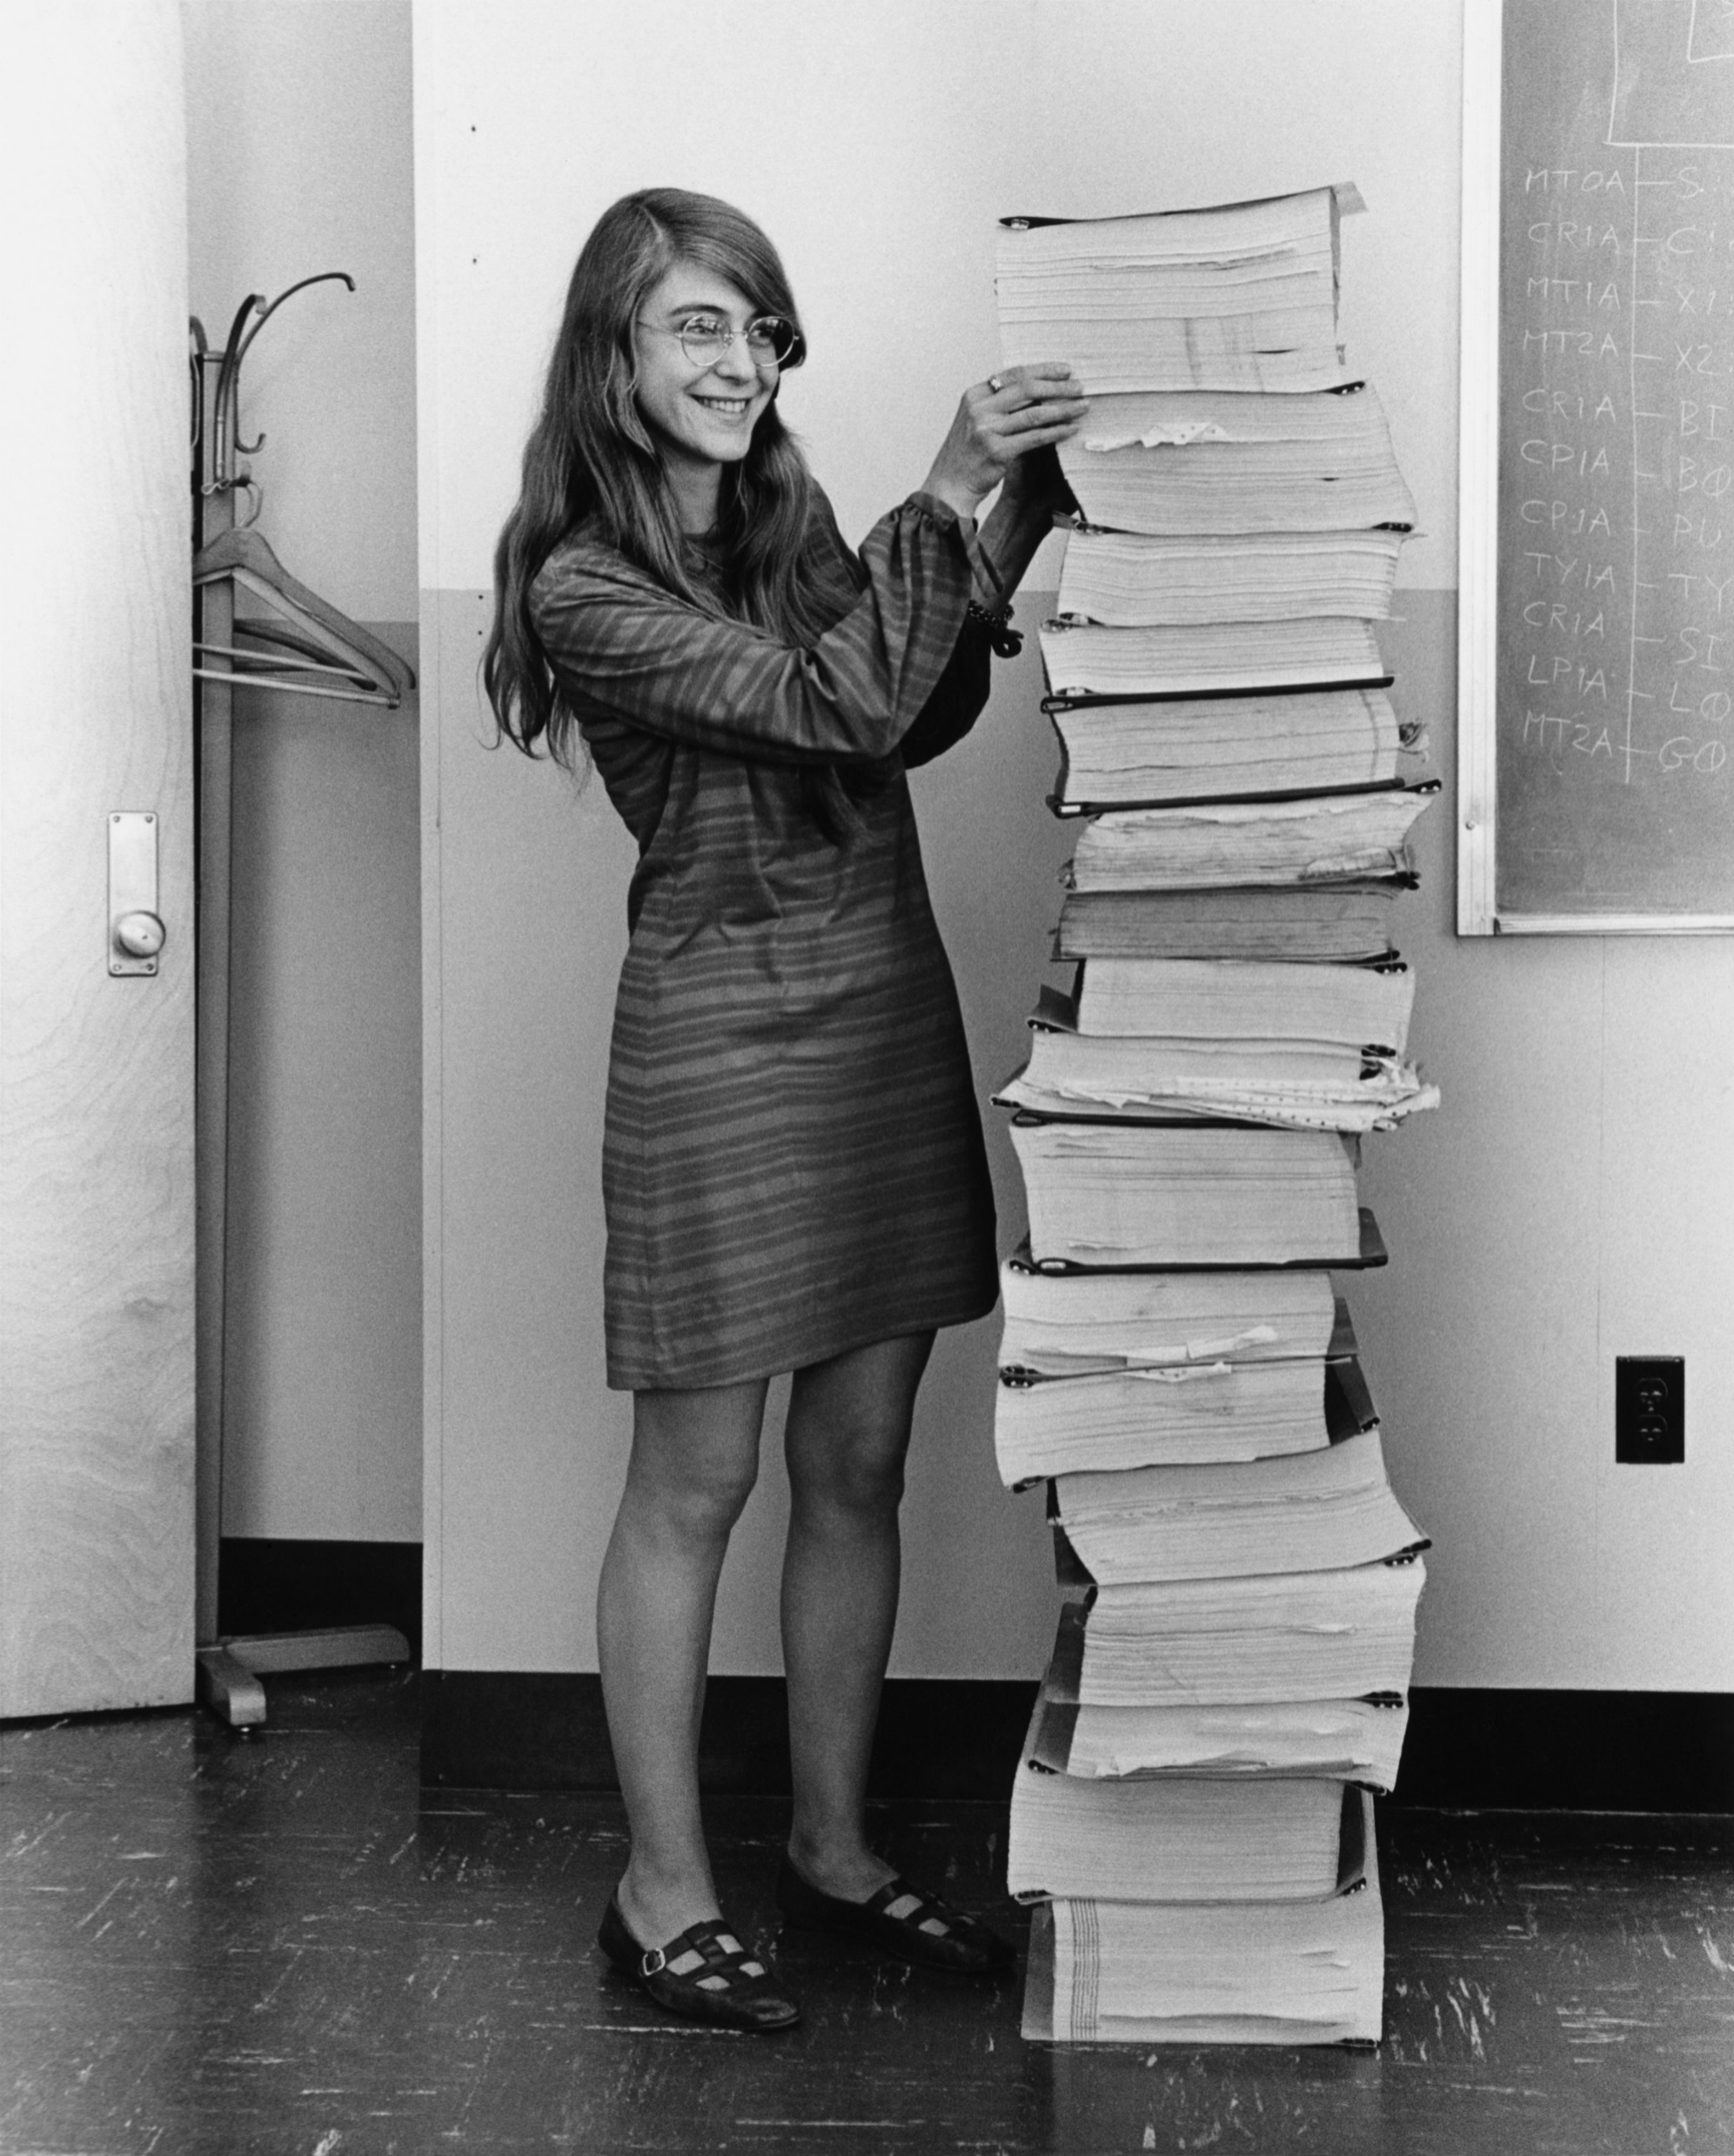
Printouts

Slide 29
Workflow
Punch cards and JCL
Submit JCL and deck for compilation
Twiddle thumbs
Get deck back
Compilations errors ☹
Type new cards
Rinse and repeat
Similar process for execution

Slide 30
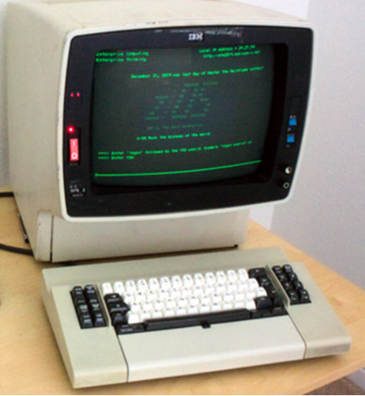
And then … IBM 3270 display terminal (green screen) VT100 80 x 24 characters

Slide 31
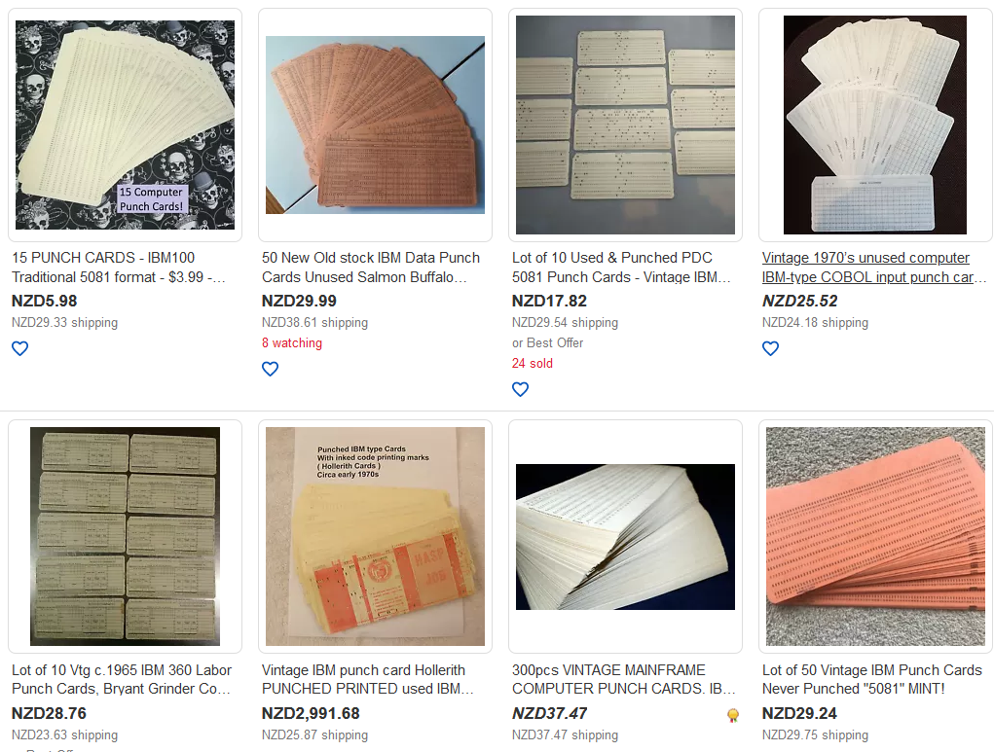
Punch cards aren’t dead – they just end up on eBay!

Slide 32
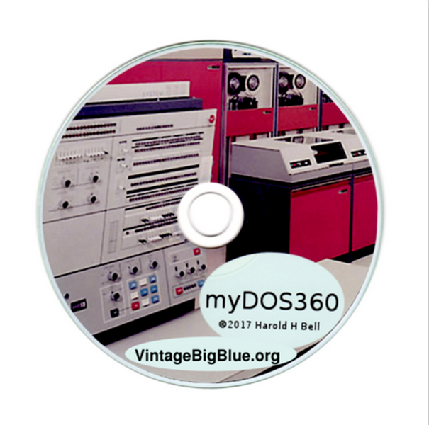
myDOS360 provides the GUI to run the first operating system that was available for the revolutionary IBM System 360 computer. It has COBOL, FORTRAN, RPG, and PL/1 compilers.

Slide 33
Programming Languages

Slide 34
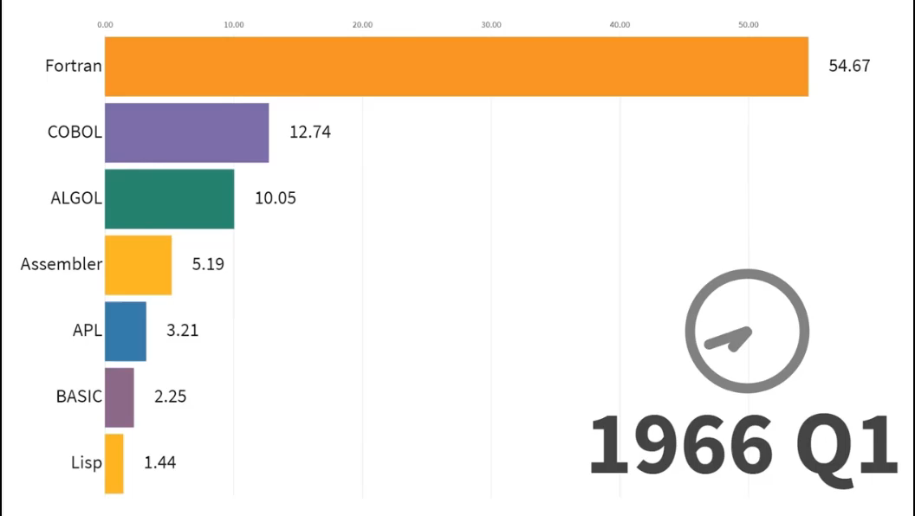
Timeline

Slide 35

From this:

Slide 36
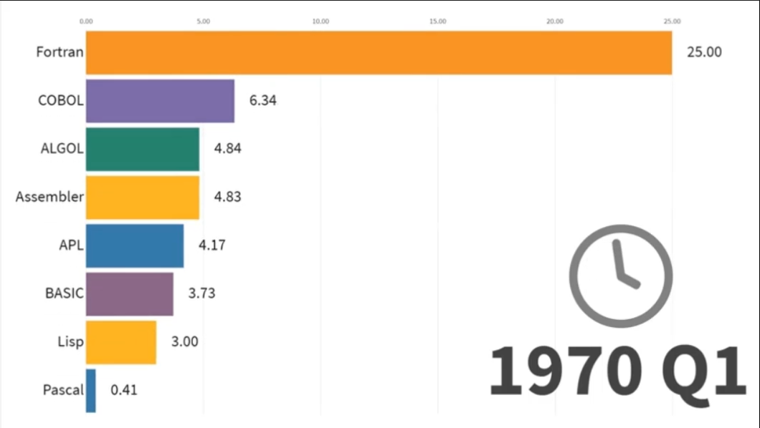
Via this:

Slide 37
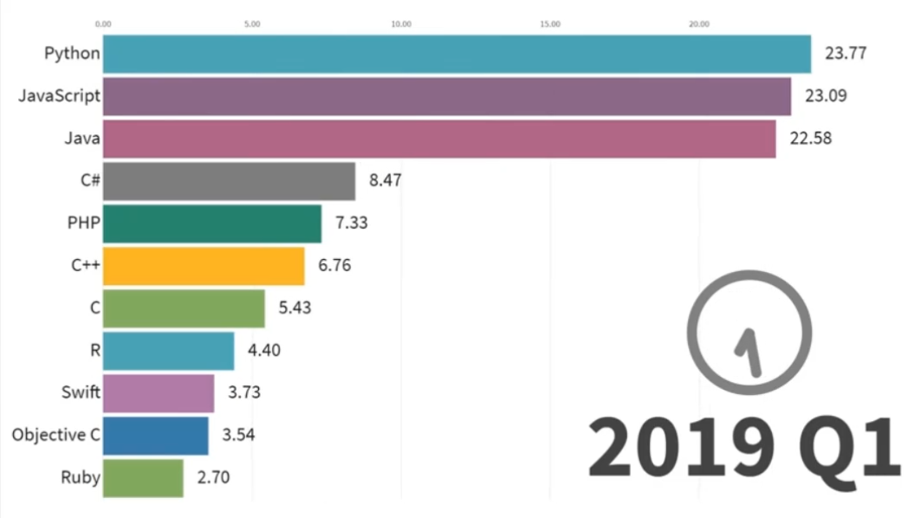
To this:

Slide 38
The PC – circa 1980

Slide 39
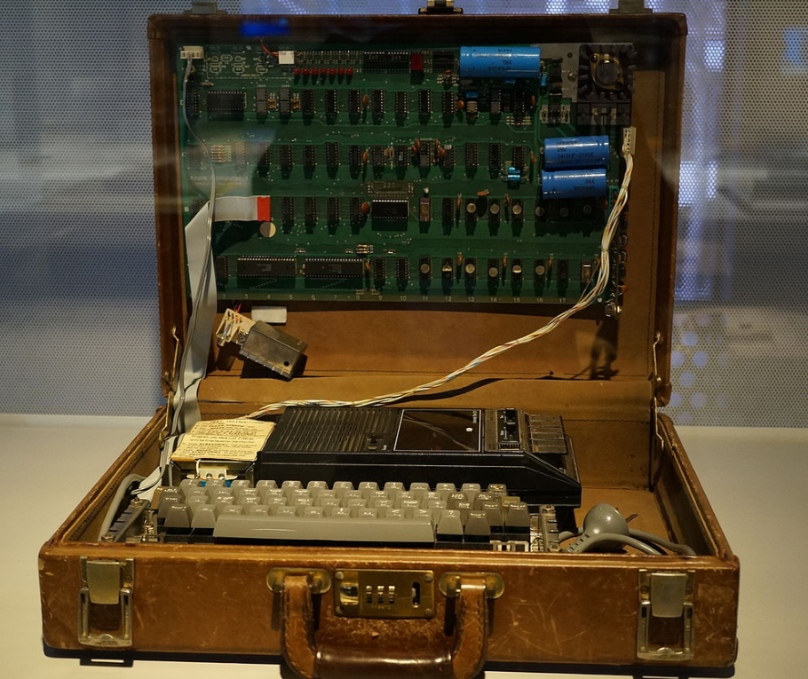
Apple 1 - 1976

Slide 40
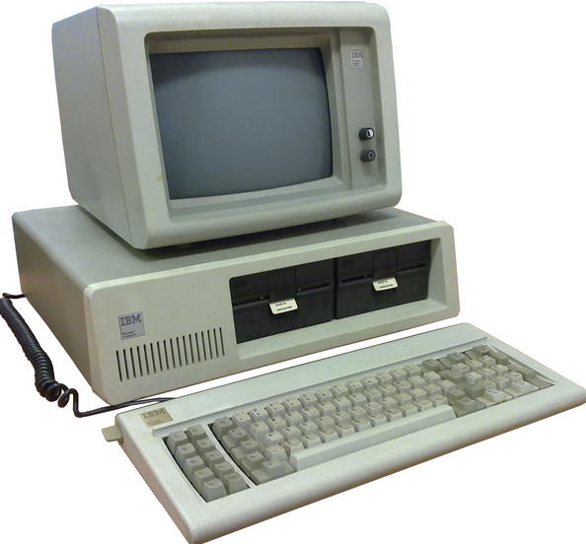
IBM PC - 1981

Slide 41
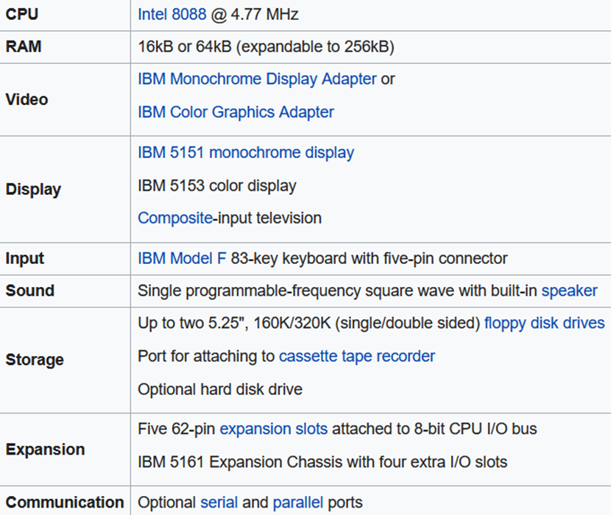
IBM PC

Slide 42
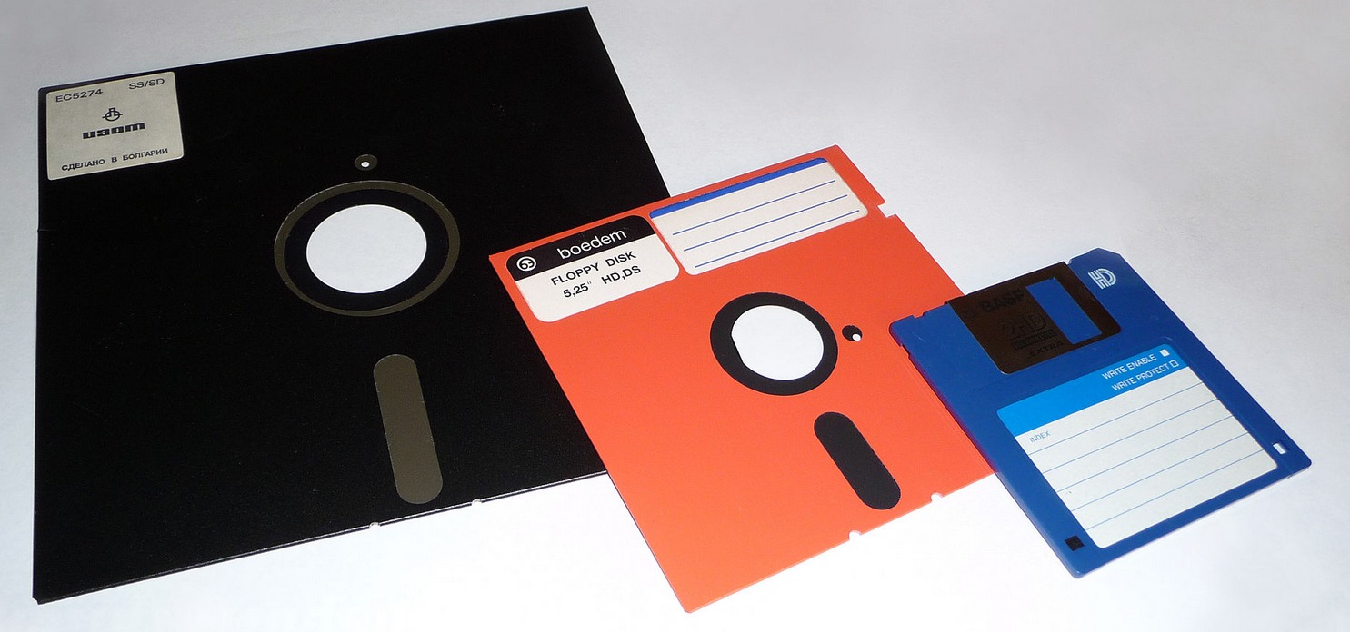
Floppy drives – 8”, 5 ¼”, 3 ½”

Slide 43
Floppy drive
8” - 240K bytes
5 1/4“ – 160K / 320K bytes (single / double sided)

Slide 44
Memory
Expanded memory is addressed from within the lower 1MB space, usually above 640K.
Extended memory has addresses greater than 1MB

Slide 45
Terminate and stay resident
A terminate-and-stay-resident program (commonly TSR) is a computer program running under DOS that uses a system call to return control to DOS as though it has finished, but remains in computer memory so it can be reactivated later. This technique partially overcame DOS's limitation of executing only one program, or task, at a time. TSRs are used only in DOS, not in Windows.
Some TSRs are utility software that a computer user might call up several times a day, while working in another program, using a hotkey.

Slide 46
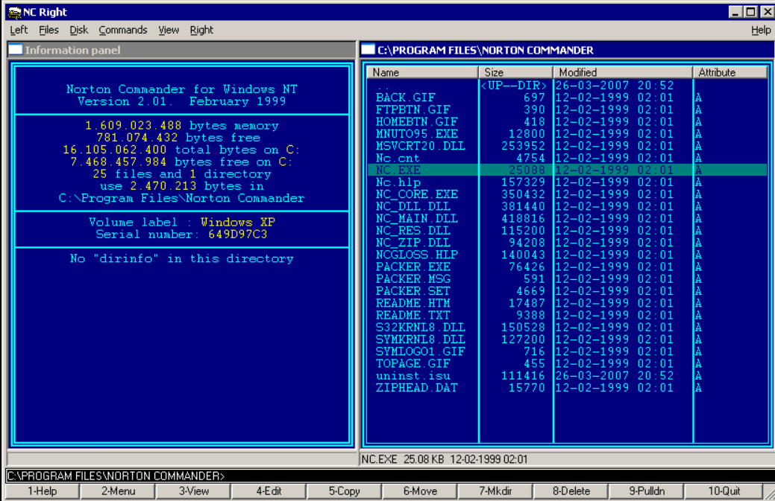
Norton Commander

Slide 47
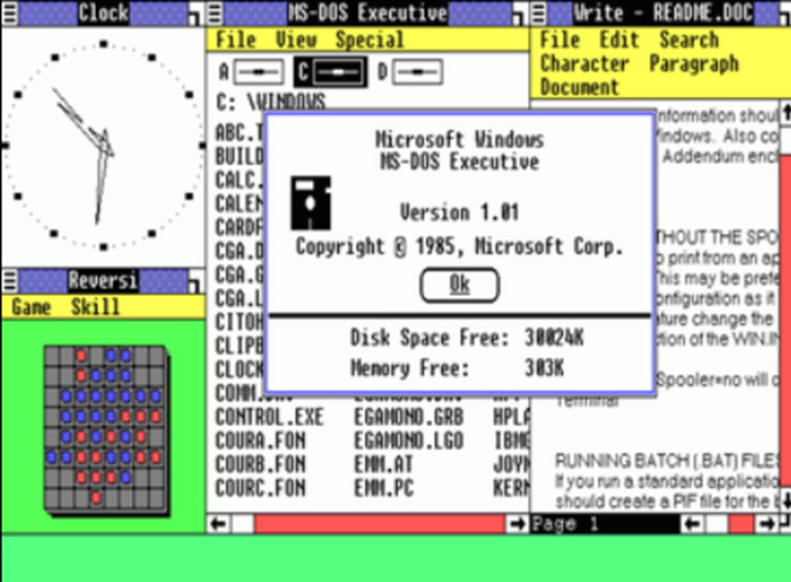
Windows 1.0
Requires two floppy
disk drives
and 192 KB of RAM

Slide 48
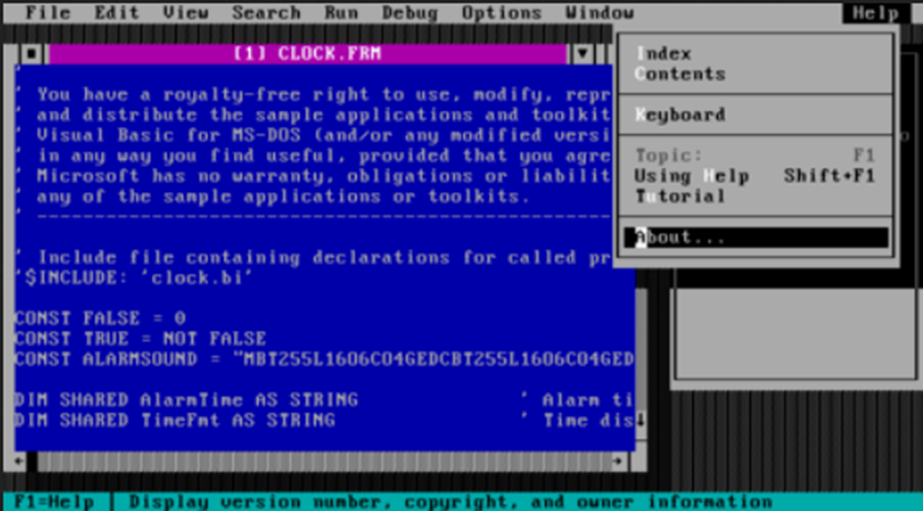
Visual Basic (1991)

Slide 49
The “Internet”

Slide 50
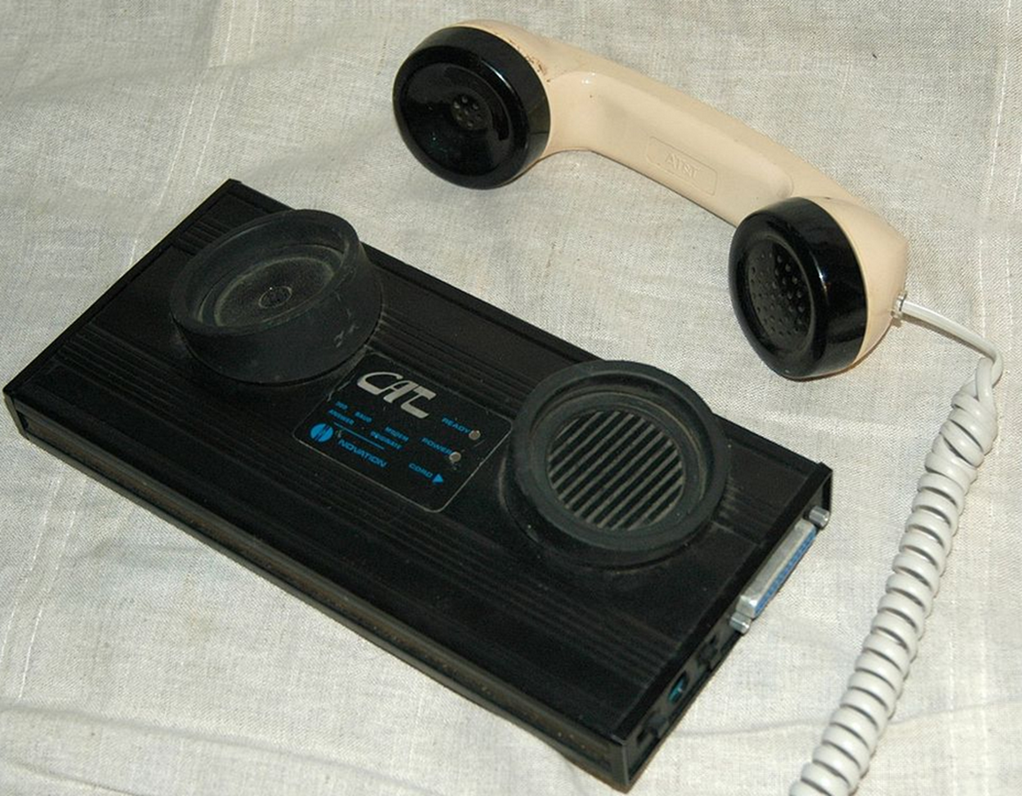
Acoustic Coupler (1200 baud = 150 bytes / sec = 540 K per hour)

Slide 51
Games

Slide 52
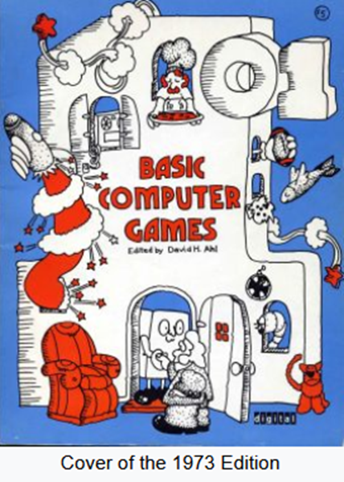
Davis Ahl – Basic Computing Games

Slide 53
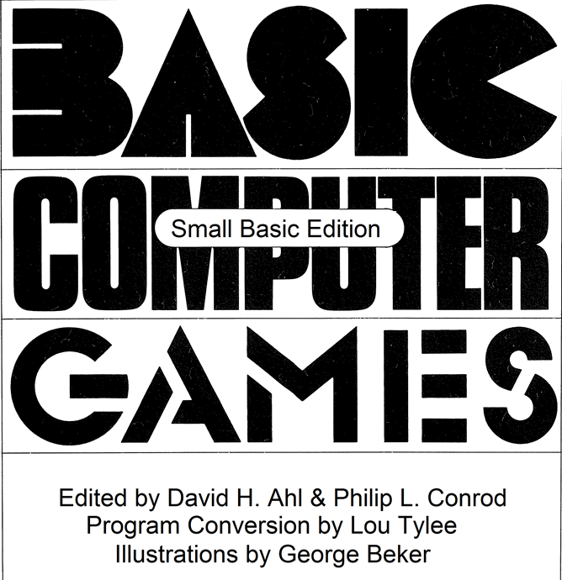
Basic Computing Games – Small Basic

Slide 54
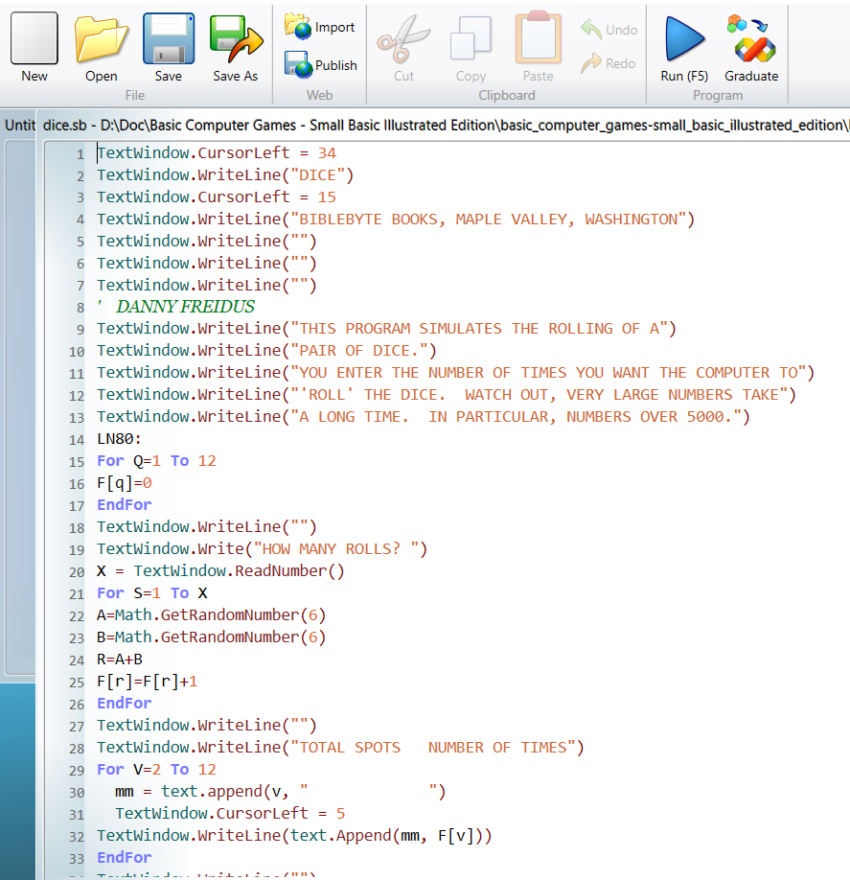
Basic Computing Games – Small Basic

Slide 55
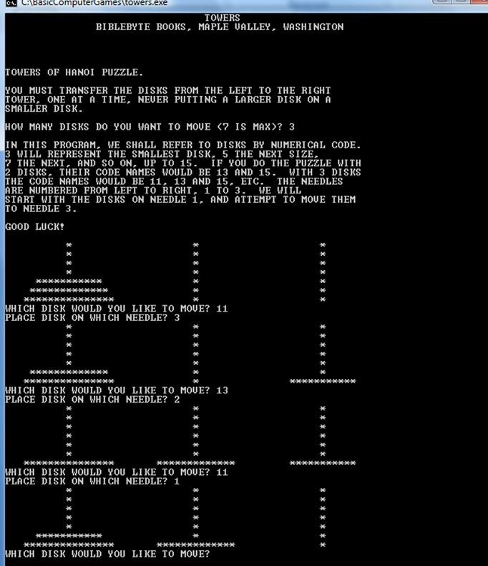
Basic Computing Games – Towers of Hanoi

Slide 56
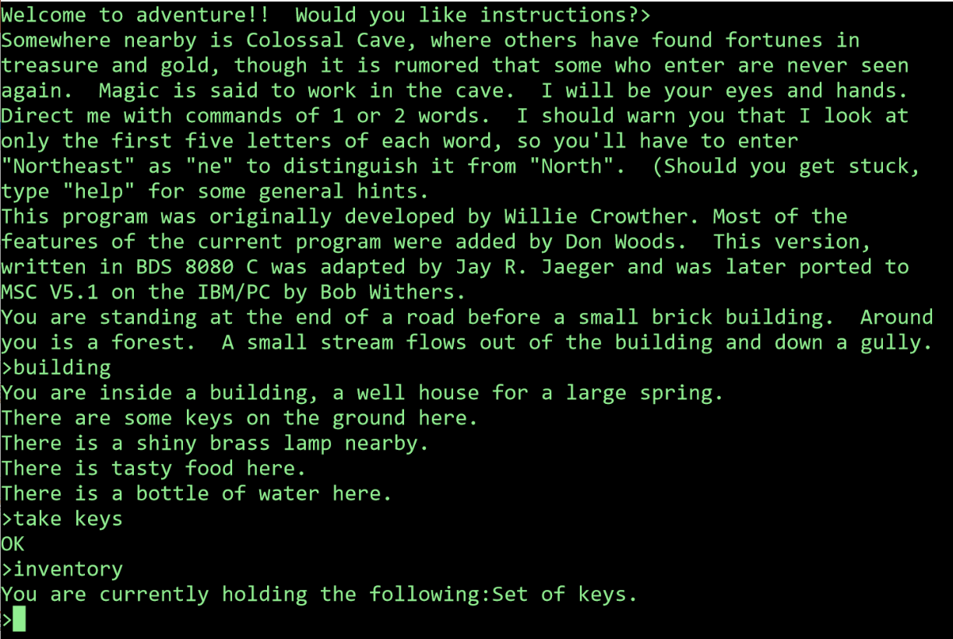
Colossal Cave Adventure

Slide 57
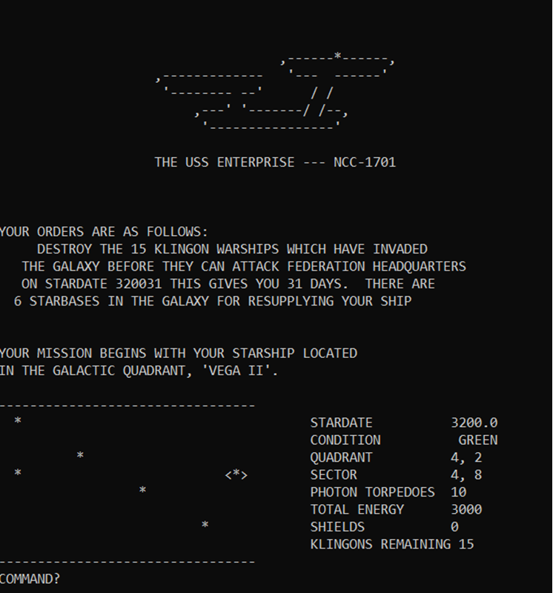
Star Trek

Slide 58
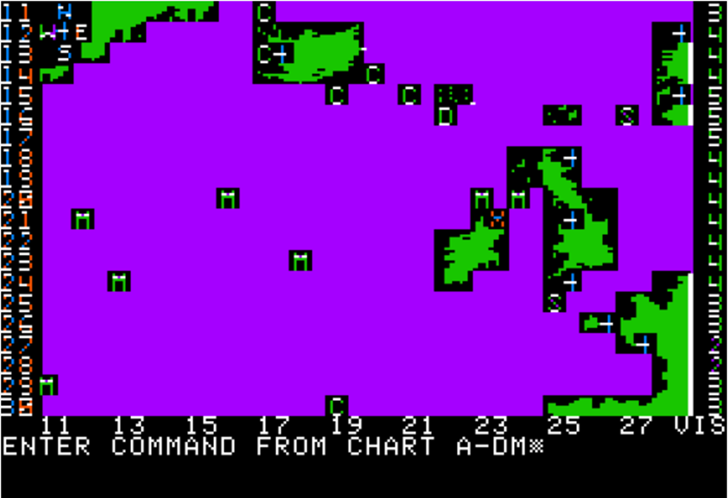
Computer Bismarck

Slide 59
Is COBOL dead?

Slide 60
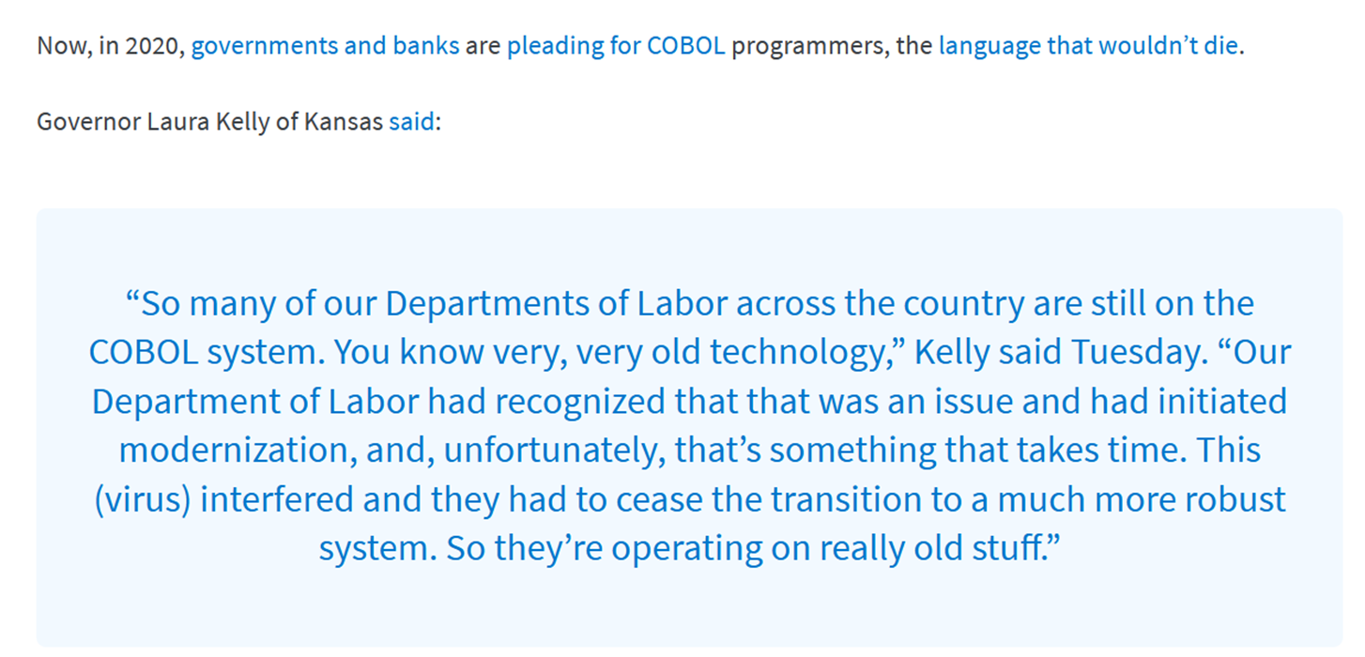

Slide 61
Bonus!

Slide 62
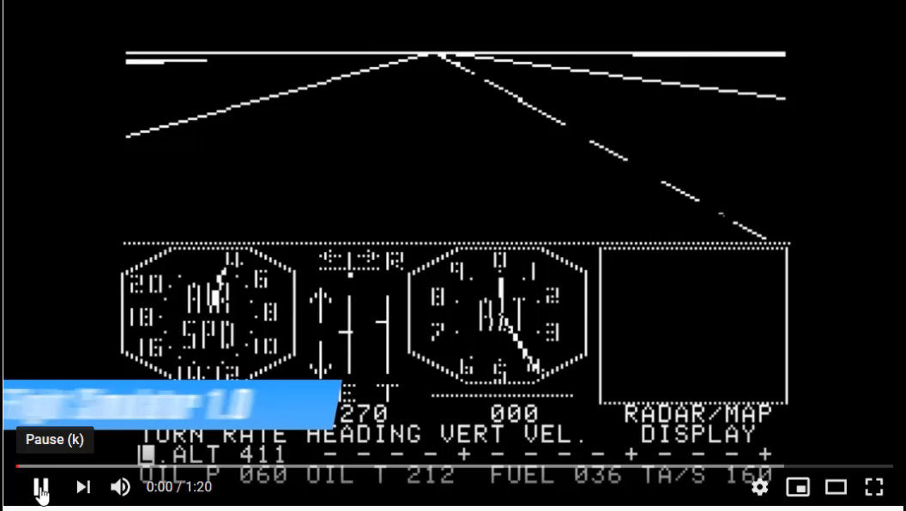
Microsoft Flight Simulator

Slide 63


Slide 64
References
The Computer History Museum - https://www.computerhistory.org
Tape drive - https://www.youtube.com/watch?v=7Lh4CMz_Z6M
Programming languages 1965 – 2019 - https://www.youtube.com/watch?v=Og847HVwRSI
Microsoft Flight Simulator - https://www.youtube.com/watch?v=gPuEb7BclsQ
Basic Computer Games – Small Basic -https://www.kidwaresoftware.com/SmallBasicComputerGames/
Colossal Cave Adventure - https://www.microsoft.com/en-nz/p/colossal-cave-adventure/9wzdncrdlv4h?activetab=pivot:overviewtab

Slide 65
References
Punching the cards - https://www.youtube.com/watch?v=YnnGbcM-H8c
IBM PC - https://en.wikipedia.org/wiki/IBM_Personal_Computer

